Slide 1


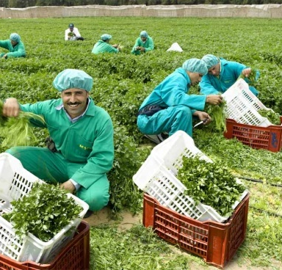

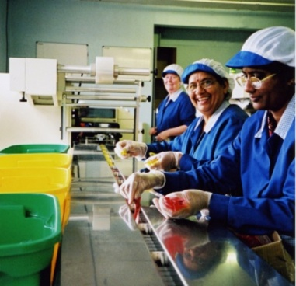
Alex Thomas
Head of Supplier Member Engagement

Slide 2
Sedex mission
Sedex is the supplier of choice for responsible supply chain management
Through supporting our members in achieving their objectives working standards globally can improve
We will do this by;
    Being the best platform
    Developing support services that meet our members needs
    Retaining a focus and commitment on reducing duplication and driving convergence

Slide 3
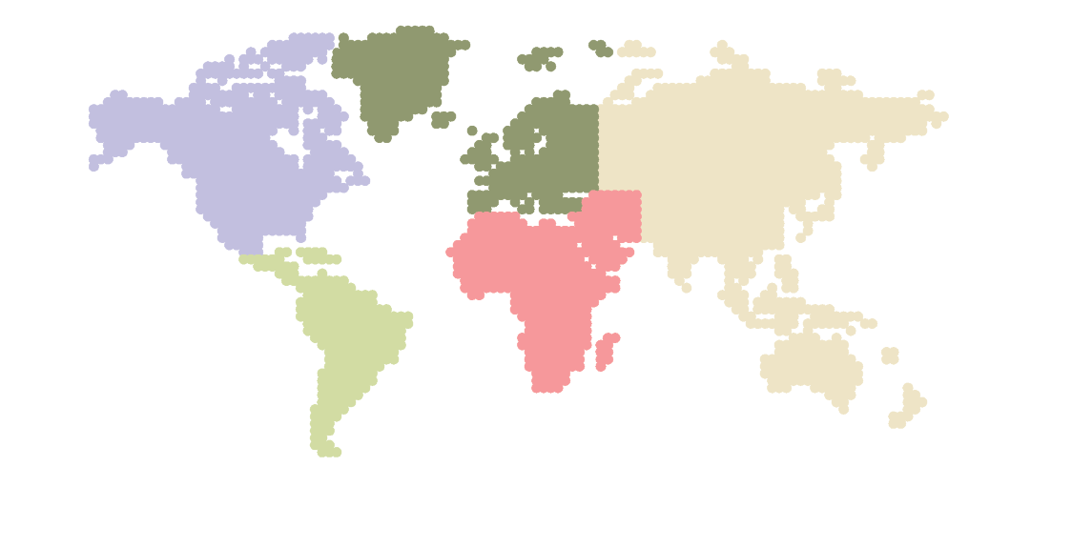
2011 Highlights
Platform improvements
Continued growth
Greater helpdesk support
New offices
New Sedex website
Continued collaboration
Greater global awareness

Slide 4
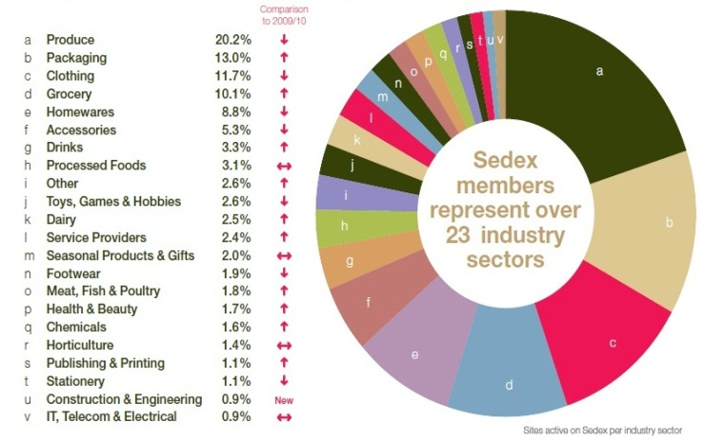
Looking forward
Continued focus on the platform
Build our support services
Attract new members globally
Provide greater analysis and insights
Greater Supplier Member engagement
Improved platform training
Revised SMETA audit
Continued collaboration

Slide 5

Suppliers are key
Suppliers deliver change and own the solution
Suppliers are vital to customers and consumers
Suppliers are fundamental to Sedex

Slide 6
Challenges of suppliers
Multiple audits
Multiple information requests
Understanding customer needs
Addressing the issues
Beyond compliance

Slide 7
We’ve listened to your feedback
Free and accessible resources and events for members including
  Supplier Workbook
  Global events
  Pilot Advocates program

Slide 8

Supplier Workbook
Supplier Workbook being developed with Verité
A free resource for members
Members will become more self-sustainable in the future

Slide 9
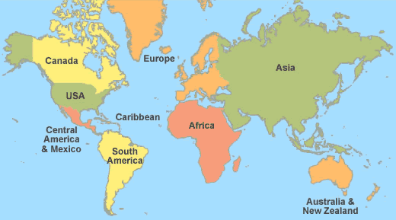
Global events
5 UK Focus Groups across
the UK
51% of our B members are in these 5 countries
Focus groups in China
2 focus groups in Chile, Conference in May
Events in India (TBC)
Events in South Africa (TBC)

Slide 10
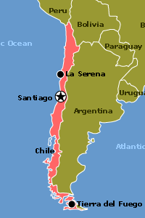

Pilot Advocates Program
Pilot of ‘Advocates’ program in Chile- Jose Melero
Santiago conference
2 focus groups in April
Online Chile B Member community
Local support and Sedex presence

Slide 11

Into 2013
More developments and events
Your input is absolutely critical!
Alex Thomas
alex.thomas@sedexglobal.com
+44 207 9022 310
Jose Melero
jmelero@cicloambiente.cl
2 2634759.

